Slide 1
Enhancing Plant Health with AI: Thermal Imaging and Image Processing
ECE 501
Instructor: Dr. Jafar Saniie
Summer 2023
Illinois Institute of Technology

Slide 2

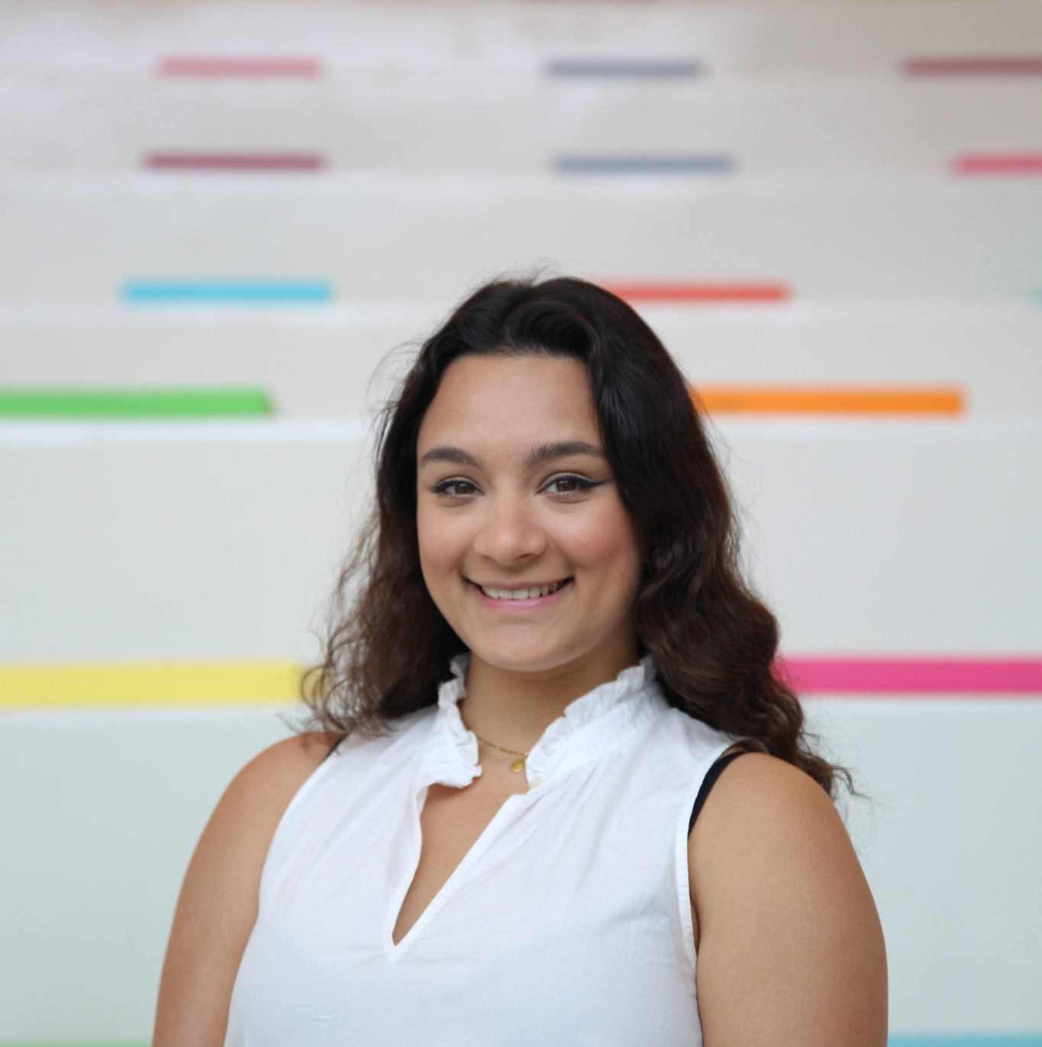

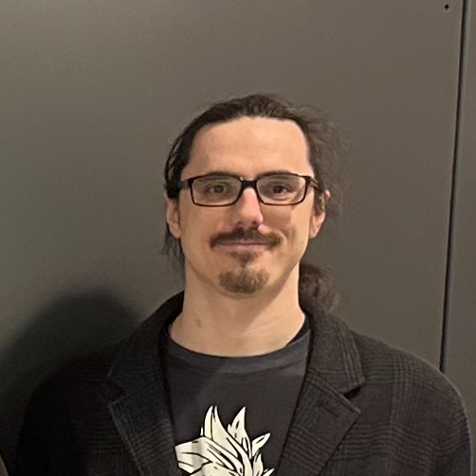
Meet the team:
Alan Palayil
Zahra Tolideh
Lukas Klicker
B.S. Computer and Cybersecurity Engineering
M.S Cybersecurity Engineering
B.S. Computer and Cybersecurity Engineering
M.S Computer Engineering
B.S. Electrical Engineering
M.S Computer Engineering

Slide 3
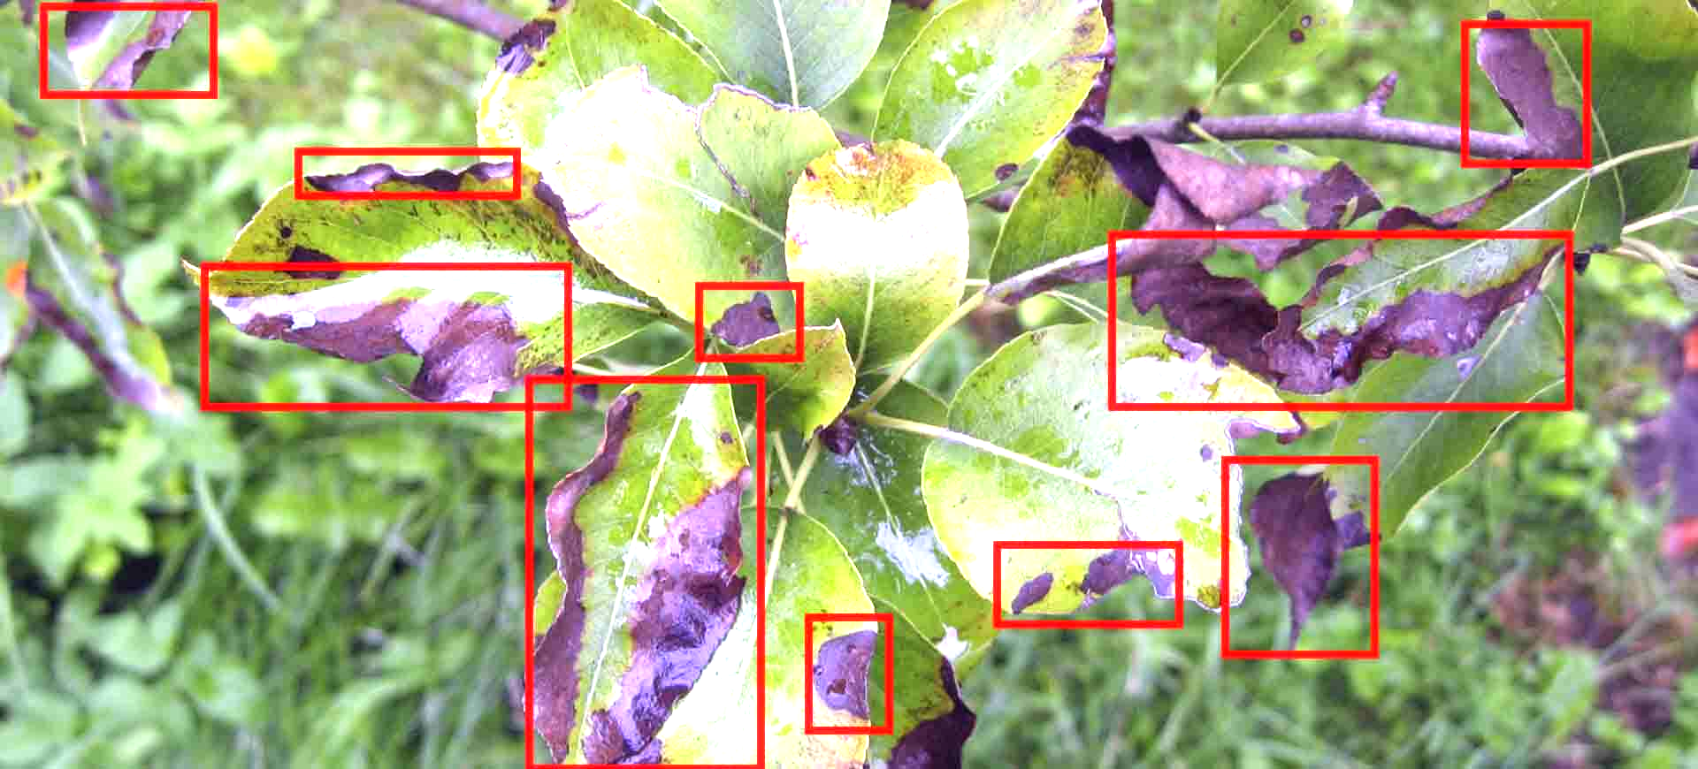
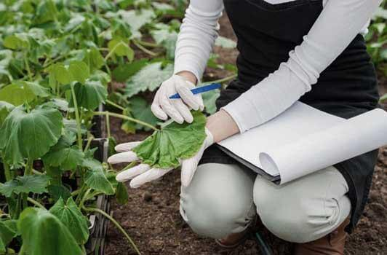
Our Project:
Objectives:
Optimize water usage
Improve plant health and growth
Enhance resource efficiency and sustainability
Importance of Smart Irrigation:
Water scarcity and increasing global population
Inefficient water usage
Precise and targeted watering
Utilizing Thermal Imaging and AI:
Leveraging thermal imaging technology to monitor plant temperature
Deep learning algorithms for disease detection and leaf analysis
Incorporating Vapor Pressure Deficit (VPD) calculations
for improved water uptake
Benefits:
Conservation of water resources
Reduction in water stress and enhanced plant health
Increased agricultural productivity and yield
Mitigation of infectious disease spread
Contribution to food security and sustainability
Notes:
Objectives:
Optimize water usage in agricultural irrigation
Improve plant health and growth through early detection of issues
Enhance resource efficiency and sustainability in farming practices
Importance of Smart Irrigation:
Water scarcity and increasing global population pose challenges to agriculture
Traditional irrigation methods often result in inefficient water usage
AI-based smart irrigation offers a solution for precise and targeted watering
Utilizing Thermal Imaging and AI:
Leveraging thermal imaging technology to monitor plant temperature
Deep learning algorithms for object detection and leaf analysis
Incorporating Vapor Pressure Deficit (VPD) calculations for improved water uptake
Expected Benefits:
Conservation of water resources
Reduction in water stress and enhanced plant health
Increased agricultural productivity and yield
Mitigation of infectious disease spread
Contribution to food security and sustainability

Slide 4
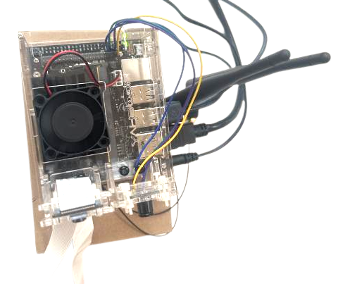
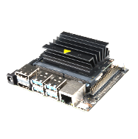
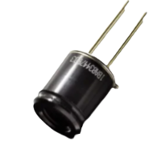
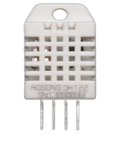
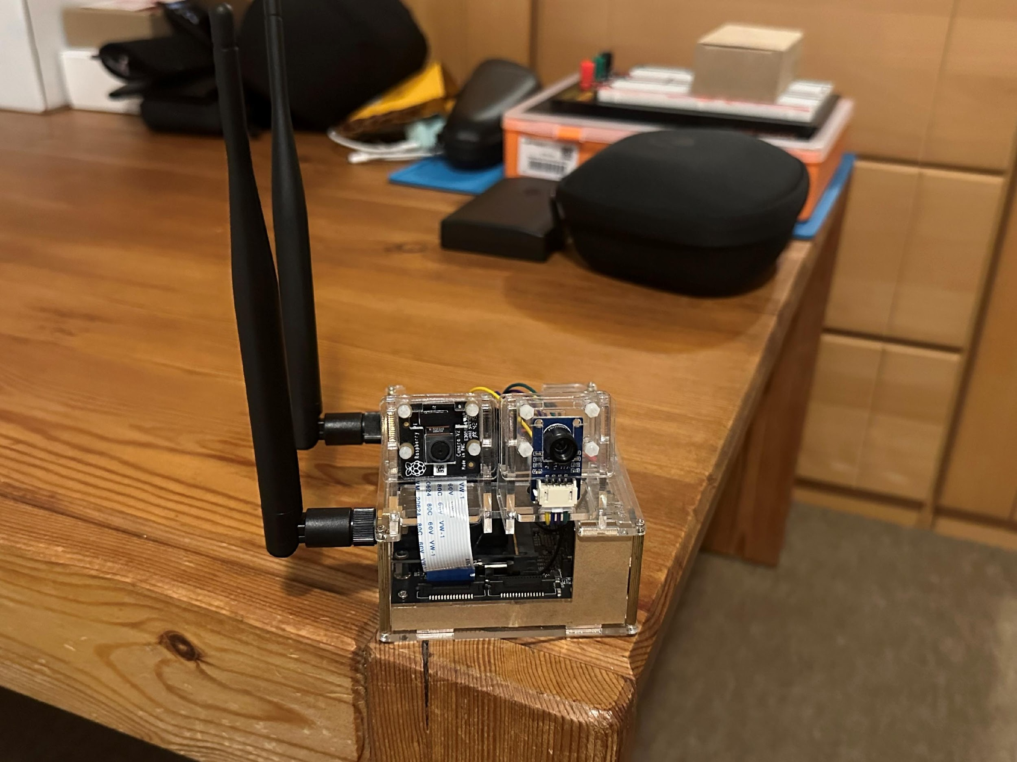
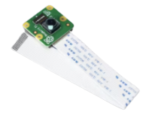
Hardware:
Thermal Imaging Camera:
Captures infrared images to measure leaf temperature
Provides continuous temperature data for analysis
RGB Camera:
Positioned to capture the plant canopy
Utilizes deep learning algorithms for leaf identification
Locates and identifies individual leaves within the plant canopy
DHT22 Sensor:
Connected to the system for ambient air measurements
Provides real-time temperature and humidity data
Enables accurate VPD calculations for precise irrigation strategies
Nvidia Jetson Nano:
Utilized as the single-board computer for processing and analysis
Powerful computing capabilities for AI algorithms and data processing
Compact and energy-efficient design for embedded applications
Notes:
Hardware Setup:
Thermal Imaging Camera:
Installed in the vicinity of the plants
Captures infrared images to measure leaf temperature
Provides continuous temperature data for analysis
Object Detection Camera:
Positioned to capture the plant canopy
Utilizes deep learning algorithms for leaf identification
Locates and identifies individual leaves within the plant canopy
Temperature/Humidity Sensor:
Connected to the system for ambient air measurements
Provides real-time temperature and humidity data
Enables accurate VPD calculations for precise irrigation strategies
Nvidia Jetson Nano:
Utilized as the single-board computer for processing and analysis
Powerful computing capabilities for AI algorithms and data processing
Compact and energy-efficient design for embedded applications

Slide 5
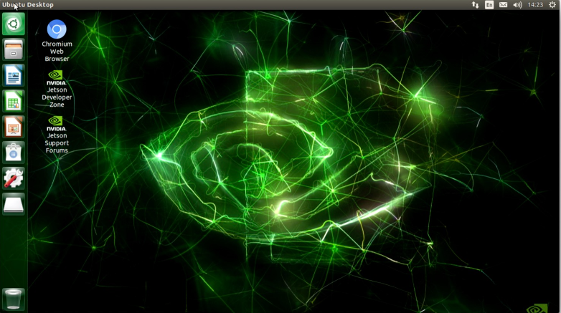




Software:
Base JetPack OS:
OS for the Nvidia Jetson Nano
Provides a stable and optimized platform for AI development
Enables seamless integration with hardware components
TensorFlow:
Deep learning framework used for training and deploying AI models
Provides a wide range of tools and libraries for AI development including pandas and sklearn.
DenseNet121 and OpenCV:
Pre-trained model for disease detection. Modified to allow custom criterias.
OpenCV is used to process the video feed into frame for the AI model.
Helps in analyzing leaf health and identify the plant and possible disease detection.
Data Management and Analysis:
Data collection from thermal imaging camera, USB camera, and sensors
Preprocessing and feature extraction for temperature and humidity data

Slide 6
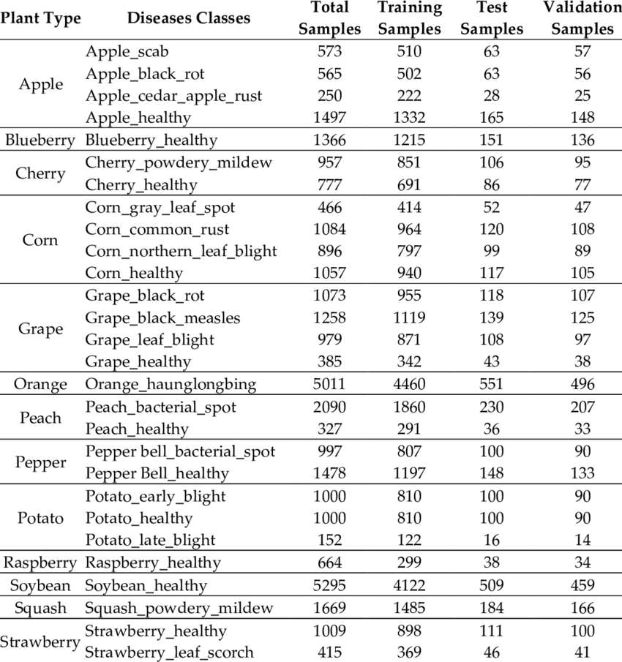
Data Collection and Analysis:
Leaf Temperature Extraction:
Thermal imaging camera captures infrared images of the leaves
Continuous stream of temperature readings from the camera
Each detected leaf region's temperature is extracted for analysis
USB Camera for Object Detection:
Object detection camera locates and identifies individual leaves
Utilizes deep learning algorithm from Tensorflow
Vapor Pressure Deficit (VPD) Calculation:
Temperature and humidity sensor measures ambient air conditions
VPD is calculated using temperature and humidity readings
Data Analysis:
Analyzing the temperature differential between leaves and ambient air
Evaluating VPD values to assess water stress levels
Determining irrigation requirements based on predefined rules and algorithms
Frequency of Data Collection:
Temperature and humidity readings obtained at regular intervals
Leaf temperature and object detection analysis performed on a continuous basis

Slide 7
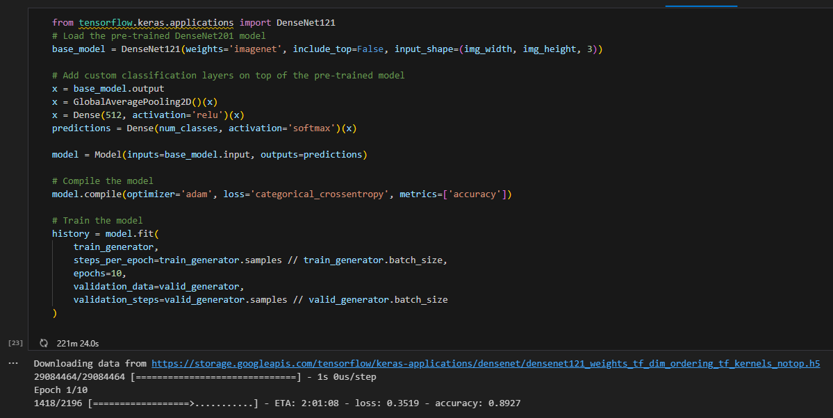
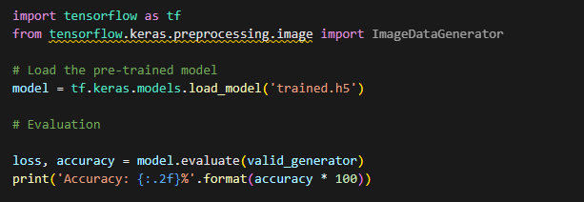
Project's Coding Methodology:
Data Output from Thermal Camera and DHT22 sensor:
Develop a Data Extraction Program for DHT22 Sensor and Thermal Camera to Populate a Database for VPD Application Integration.
Video Processing from the USB Camera:
The program utilizes OpenCV to convert the video feed from the camera into frames. The primary requirement is to save only the frames captured during periods without blackouts. These frames are then stored in the directory designated for use by the AI model.
Plant Identification and Disease Detection:
This Python program utilizes Keras from Tensorflow to identify plants based on their leaves, and incorporates a pre-existing dataset for disease detection. The program employs a pre-trained local model to continuously test and enhance its performance.
Vapor Pressure Deficit (VPD):
The program is designed to calculate values obtained from the DHT22 sensor and thermal camera, and based on predefined statistics, adjust the irrigation timing.

Slide 8
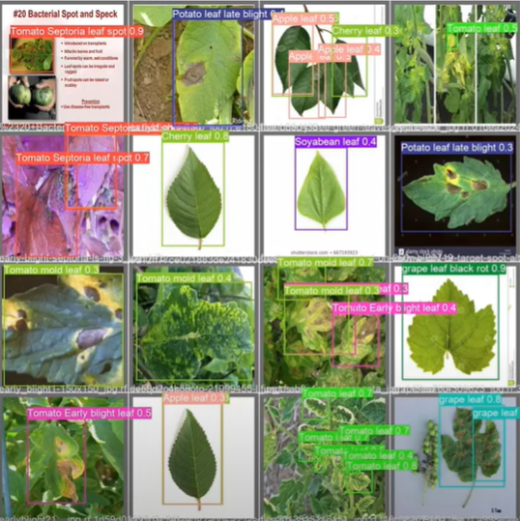
Testing & Evaluation:
System Functionality Testing:
Validate the functionality of the AI-based smart irrigation system
Ensure proper operation of hardware components and software integration
Conduct thorough testing to identify any issues or limitations
Performance Evaluation:
Assess the system's performance in optimizing water usage
Evaluate the effectiveness of the irrigation strategies implemented
Measure the system's ability to maintain optimal plant hydration levels
Comparative Analysis:
Compare the performance of the AI-based system with traditional irrigation methods
Assess the improvements in water usage efficiency and crop productivity
Analyze the economic and environmental benefits of adopting the new system

Slide 9
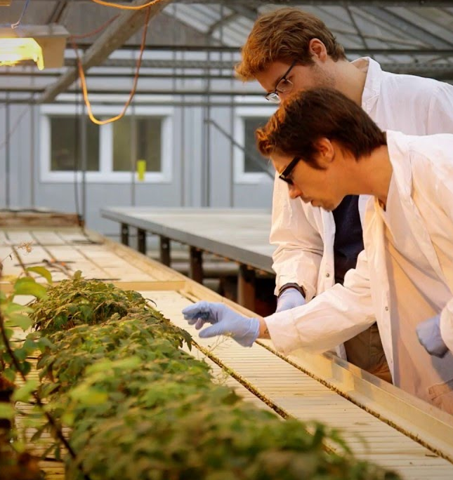
Feedback & Optimization:
Continuous Monitoring:
Utilize sensors and monitoring systems to gather real-time information
Monitor factors such as soil moisture levels, plant vigor, and yield
Data Analysis:
Analyze the collected data to identify patterns and trends
Assess the effectiveness of the irrigation strategies implemented
Identify areas for improvement and optimization
Feedback Loop:
Establish a feedback loop to incorporate insights into system optimization
Modify algorithms and thresholds based on observed outcomes
Machine Learning:
Train models using historical data to predict optimal irrigation schedules
Use machine learning algorithms to adapt to changing environmental conditions

Slide 10
Work Distribution:
Name | Upcoming Week's Distribution | Milestones Achieved
Alan Palayil | Implement the model into Jetson Nano Create a program to extract a frame from Camera to push to the model | Hardware setup Dataset for Plant Detection Dataset for Plant Diseases Design the AI model for Plant detection and diseases.
Zahra Tolideh | Create a program to extract the data from the DHT22 to input it into the VPD program Help Lukas with debugging | Hardware setup Create VPD Calculation program Design irrigation strategies using predefined metrics.
Lukas Klicker | Extract data from the thermal image Debug DHT22 GPIO connection for the VPD Create a manual for the Project report | Hardware setup Thermal imaging working simultaneously with USB Camera

Slide 11
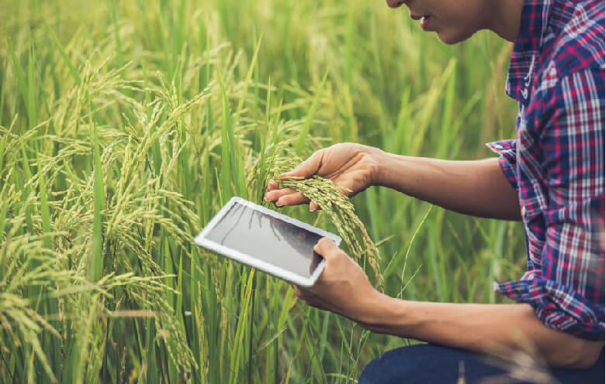
Conclusion:
Optimization of Water Usage:
By analyzing data from thermal imaging, VPD, and object detection, the system determines irrigation strategies.
Promotion of Sustainable Agriculture:
The system enables precise irrigation scheduling based on real-time plant needs, reducing the use of water, fertilizers, and pesticides.
Ensuring Food Security:
Early detection of plant health issues enables timely intervention, minimizing crop losses.
The AI-based smart irrigation system offers economic benefits by reducing production costs and increasing crop productivity.
Future Scope:
Continuous monitoring, feedback analysis, and system optimization will drive further improvements.
The integration of emerging technologies and advanced AI algorithms will enhance the system's capabilities.

Slide 12
References:
https://www.ncbi.nlm.nih.gov/pmc/articles/PMC7161382/
https://developer.nvidia.com/blog/jetson-projects-of-the-month-ai-thermometer-and-self-navigating-robot-for-search-and-rescue/
Project example using jetson nano a rgb camera and a thermal camera to create a contactless thermometer
https://www.sciencedirect.com/science/article/pii/S2352484722013543
Smart Irrigation project using 2 models based on environmental factors like soil moisture, rain, and temperature.
https://www.ncbi.nlm.nih.gov/pmc/articles/PMC6919419/
Vapor Pressure Deficit Study regarding its effects on evapotranspiration based on plant parameters.
https://www.frontiersin.org/articles/10.3389/fpls.2019.00103/full#:~:text=Water%20use%20efficiency%20(WUE)%20is,water%20used%20by%20the%20crop.
Water-Use Efficiency Study regarding crops in changing environmental factors explores leaf level interactions.
https://www.researchgate.net/figure/Thermal-images-of-healthy-cucumber-leaves-upper-and-leaves-inoculated-with-FOC-lower_fig3_232719555
Studying using thermal imaging for analysis of the health of cucumber leaves.

Slide 13
References:
7. Various Studies on Irrigation scheduling based on water stress index
Canopy Temperature-Based Water Stress Indices for Irrigation Scheduling in Corn authored by J. W. Jones, H. R. Jensen, D. C. Tsegaye, et al. published in: Agronomy Journal, 2009
Found canopy temperature as a useful water stress indicator for optimal irrigation scheduling and water efficiency
Estimating Crop Water Stress Index of Winter Wheat Using Canopy Temperature Difference and Leaf Area Index by Wang, C., Li, Y., Li, Y., et al. published in: Agricultural Water Management, 2016
Study that utilized thermographic values to estimate the temperature of the canopy for water stress detection for informed irrigation decision making.
8. https://pulsegrow.com/blogs/learn/vpd
VPD information and references

Slide 14
Project Demonstration
Presentation on the Current Progress:
A Visual Journey between Hardware and Software

Slide 15

Video Demonstration:

Slide 16
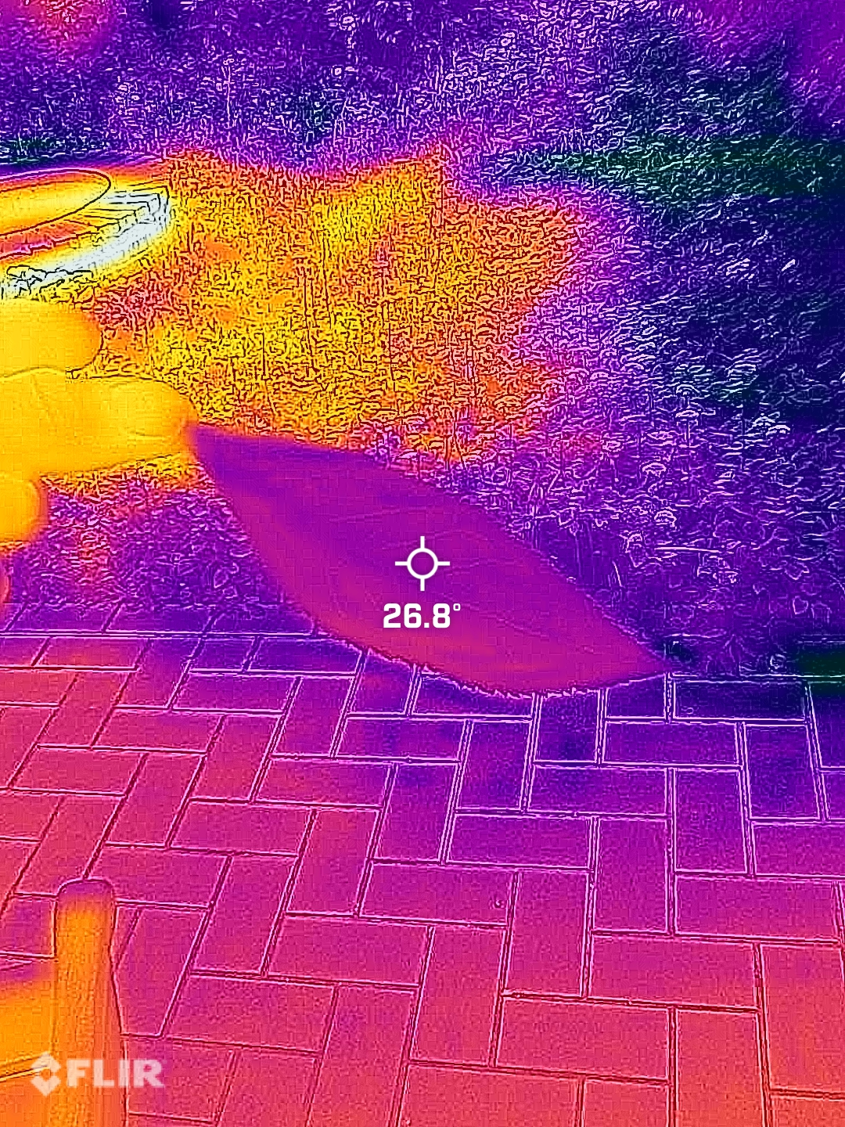
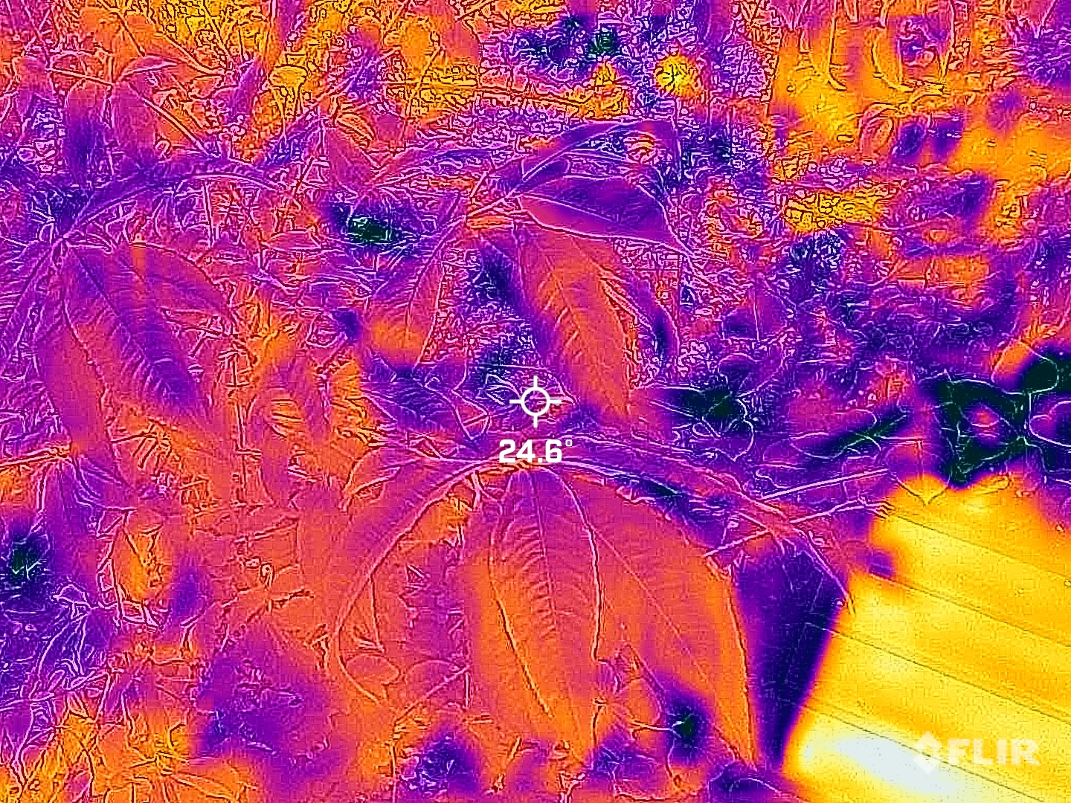
Hardware Results:
Lepton FLIR ONE (Lepton)

Slide 17
Hardware Specifications:
 | Current Prototype | Final Prototype Goal
Single Board Computer | Jetson Nano | Jetson Nano
Network | WiFi | WiFi
RGB Camera | IMX219 | IMX477
Thermal Imaging | MLX90640 | Lepton 3.5
Environmental Sensor | DHT22 (Unfulfilled) | DHT22 via Slave SHT11/AHT10 for I2C

Slide 18
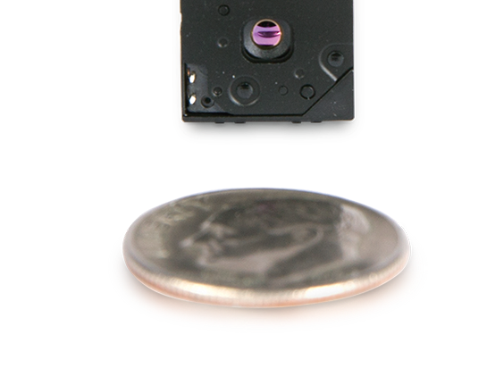
Hardware
Thermal Camera Component | Lepton 3.5 | MLX90640
Manufacturer | FLIR | Melexis
Sensor Type | Microbolometer | Infrared Array
Resolution | 160x120 pixels | 32x24 pixels
Pixel Pitch | 12μm | 17μm
Field of View (FOV) | 50° H x 38° V | 55° H x 35° V
Temperature Range | -40°C to 150°C (-40°F to 302°F) | -40°C to 300°C (-40°F to 572°F)
Accuracy | ±5°C (±9°F) or ±5% of reading | ±2°C (±3.6°F) or ±2% of reading
Refresh Rate | 8.7 Hz (NTSC) / 7.5 Hz (PAL) | 0.5 to 64 Hz
Interface | SPI | I2C, SMBus
Operating Voltage | 2.8V - 3.3V | 3.3V
Power Consumption | 3.1V, 150mW (typical) | 3.3V, 85mA (typical)
IFOV(mrad) | 5.45 | 29.98
IFOV(inch) @ 10ft | 1.31 | 7.20
Thermal Imaging Camera
MLX90640 (32x24)
Lepton 3.5 (160x120)
[2]Lepton 3.5 https://www.flir.eu/products/lepton/
[3]MLX90640 datasheet https://www.melexis.com/en/documents/documentation/datasheets/datasheet-mlx90640
[4] FLIR Size Distance ratio thermal camera’s IFOV https://www.flir.com/discover/professional-tools/understanding-distancesize-ratio/
Notes:
Wasted real estate
Bold text
Stick with theme – don't use darks

Slide 19
Hardware RGB Camera
Feature | IMX219 | IMX477
Manufacturer | Sony | Sony
Sensor Type | CMOS | CMOS
Resolution | 8.3 Megapixels (3280 x 2464) | 12.3 Megapixels (4056 x 3040)
Pixel Size | 1.12μm | 1.55μm
Image Sensor Format | 1/4 inch | 1/2.3 inch
Dynamic Range | 10-bit | 10-bit
Frame Rate | Up to 30 fps | Up to 60 fps
Shutter Type | Rolling Shutter | Rolling Shutter
Lens Mount | M12 | CS-mount
Field of View (FOV) | Varies depending on the lens used | Varies depending on the lens used
Focus Type | Fixed focus | Adjustable focus
Interface | MIPI CSI-2 | MIPI CSI-2
Operating Voltage | 2.5V | 1.2V
Power Consumption | 250-300mW (typical) | 500-600mW (typical)
Dimensions | 25 x 23.86 mm | 25 x 23.86 mm
Weight | Approximately 3 grams | Approximately 3 grams
Supported Platforms | Raspberry Pi, Jetson Nano, etc. | Raspberry Pi, Jetson Nano, etc.
Price | $20 - $40 | $80 - $120
[5] Arducam Jetson compatibility IMX219 IMX477 https://www.arducam.com/jetson-nano-xavier-nx-camera-imx219-imx477-arducam/
Notes:
Same issue with tables – make tables not garbage by bolding label cells and center cells

Slide 20
Environmental Sensor
Feature | DHT22 | DHT11 | SHT11 | AHT10 | SHT4xA
Manufacturer | Various | Various | Sensirion AG | ASAIR | Sensirion AG
Temperature Range | -40°C to 125°C (-40°F to 257°F) | 0°C to 50°C (32°F to 122°F) | -40°C to 123.8°C (-40°F to 254.8°F) | -40°C to 80°C (-40°F to 176°F) | -40°C to 125°C (-40°F to 257°F)
Humidity Range | 0% to 100% RH | 20% to 90% RH | 0% to 100% RH | 0% to 100% RH | 0% to 100% RH
Temperature Accuracy | ±0.5°C (±0.9°F) | ±2°C (±3.6°F) | ±0.5°C (±0.9°F) | ±0.5°C (±0.9°F) | ±0.2°C (±0.36°F)
Humidity Accuracy | ±2% RH | ±5% RH | ±4.5% RH | ±3% RH | ±2% RH
Refresh Rate | 0.5 Hz | 0.5 Hz | 0.5 Hz | 0.5 Hz | 4 Hz
Interface | Digital (One-wire) | Digital (One-wire) | Digital (Two-wire, I2C or 1-wire) | I2C | I2C, SPI
Operating Voltage | 3.3V to 5.5V | 3V to 5V | 2.4V to 5.5V | 1.8V to 3.6V | 2.4V to 5.5V
Power Consumption | 2.5mA (typical) | 1-2.5mA (typical) | 3.5mA (typical) | 6μA (typical) | 2.8μA (typical)
Price | ~$4 | ~$2 | Obsolete | ~$1 | ~$4
[6] SHT4xA product page https://sensirion.com/company/news/press-releases-and-news/article/Fourth-generation-SHT4xA-digital-humidity-sensor-now-available
[7] AHT10 datasheet https://server4.eca.ir/eshop/AHT10/Aosong_AHT10_en_draft_0c.pdf
[8] SHT11 datasheet https://www.sparkfun.com/datasheets/Sensors/SHT1x_datasheet.pdf
[9] DHT11 datasheet https://www.mouser.com/datasheet/2/758/DHT11-Technical-Data-Sheet-Translated-Version-1143054.pdf
[10] DHT22 dataheet https://www.mouser.com/datasheet/2/758/DHT11-Technical-Data-Sheet-Translated-Version-1143054.pdf

